Slide 1
Rethinking the Political Economy of Decentralization:
How Democracy and Political Parties Shape the Provision of Local Public Goods
Jorge Martinez-Vazquez, Georgia State University
2018 International Conference: Issues on Fiscal Federalism
May 10-11;Brasilia
With :
Charles R. Hankla, Georgia State University
Eunice Heredia-Ortiz, DAI
Raul Ponce-Rodriguez, Universidad Autónoma de Ciudad Juarez

Slide 2
Introduction and Motivation
Decentralization is an important global trend, but its effects are still not well understood.
Theoretically, most see it as beneficial, either because:
  It allows government to target public goods to local preferences, or
  It induces healthy competition.
But others fear that:
  It discourages the provision of goods with extra-jurisdictional spillovers, or
  It has other negative impacts, including encouraging corruption and overreliance on administratively weak structures for the provision of key public goods.

Slide 3
Impact of fiscal decentralization: What makes a difference?
Economists have focused on fiscal architecture design (expend autonomy, revenue autonomy , role of transfers and borrowing )
Empirically, results on the impact on service delivery, econ growth, corruption, etc. are positive in some cases but generally mixed
Different reasons for mixed results (how FD is actually measured, endogeneity issues, differences in data and estimation etc.)
But also institutional context differ widely across countries
There has been little research linking political institutions, decentralization, and governance.
  Most institutional research is at the national level, is based on single cases, or does not consider governance as a dependent variable.
We seek to understand how political institutions can mediate the impact of decentralization on governance quality.

Slide 4
Departure point: Oates (1972) fiscal decentralization theorem
“In the absence of :
economies of scale and
inter-regional externalities,
the welfare associated with a decentralized provision of local public services is greater than the welfare associated with a uniform centralized provision ….”

Slide 5
Heterogeneity of preferences and decentralized resource allocation in a federation
U
U² (g*2)
U¹(g*1)
g*¹
g*²

Slide 6
Heterogeneity of preferences and centralized resource allocation in a federation ➔lower welfare
U
U^{2’} (g*2)
U¹(g*1)
g*¹
g*^{c}
g*²

Slide 7
2. Building our theory
The dominant view in economics:
  Decentralization Theorem (Tiebout1956 and Oates1972):
  When inter-jurisdictional spillovers are absent, sub-national governments can provide public goods more efficiently than central governments by better targeting to the desires of their constituents.
But, under what conditions will this theorem hold when spillovers are present?
  We develop a rigorous and formal extension of the decentralization theorem to determine when it will hold under the more realistic presence of spillover effects.
We seek to find out under which governance/political institutional arrangements the decentralization theorem holds even in the presence of spillovers.

Slide 8
LIMITATIONS OF FISCAL DECENTRALIZATION THEOREM
Beyond, the assumptions of no economies of scale and absence of externalities, the most important limitation is that governments are assumed to be controlled by benevolent social planners
Evidence suggests that democracy, political competition, and political institutions (electoral structure) are important determinants of the spending and taxation policies of governments (Persson and Tabellini (2002, 2003); Hettich and Winer (1999, 2006), etc.)

Slide 9
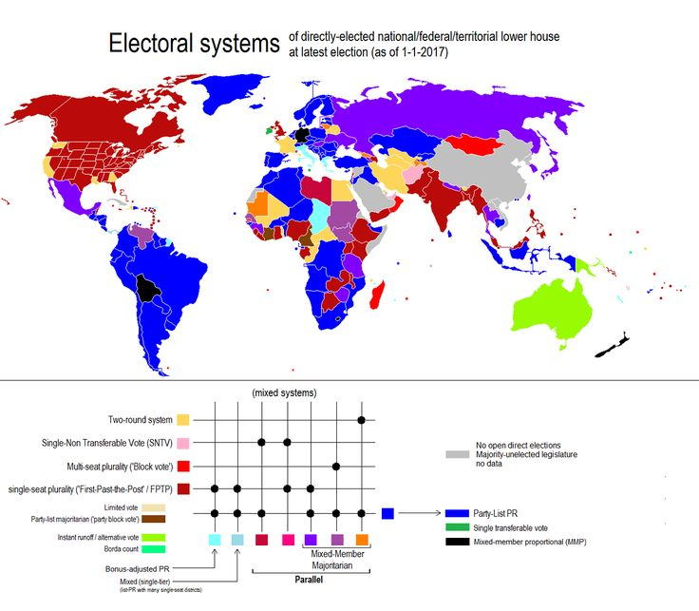
Complexity out there: Electoral Systems in the World

Slide 10
Relevant (to us) political institutions
One institution that political scientists have found to impact national policy is the organization of political parties( e.g. Hicken and Simmons 2008 for education),
These scholars contend that party centralization shifts power from local elites-- who might be tempted to shore-up their support with particularistic goods-- to national party leaders, who have electoral incentives to consider the aggregate national interest.
Of course, political economists have not neglected the sub-national level but the main focus has not been on connecting particular sub-national political institutions with public goods provision.

Slide 11
Some relevant prior literature
Riker (1964)– classical reference.. decentralized parties could be both a driver of democratic decentralization and a protector of the benefits of federalism
Wibbels (2005) -- presence of centralized parties may facilitate sub-national government market reforms
Most related to our work, Enikolopov and Zhuravskaya (2007): cross-national empirical study focusing on the impact of party centralization (but they do not measure party decentralization at the sub-national level) and fiscal decentralization (but they omit presence of democratic decentralization.)

Slide 12
We formulate a “Strong” Fiscal Decentralization Theorem
The provision of public goods with or without inter-regional externalities by a system of decentralized democratically elected sub-national governments with party centralization (nomination of local candidates) produces a greater level of welfare than the provision by a centralized government.
These arguments are formally developed for plurality electoral systems as well as for proportional electoral systems in a separate paper (Ponce-Rodriguez et al. (2017).

Slide 13
We consider 4 distinct cases of political institutional configurations:
In centralized party systems a central party committee selects candidates (and a political platform with spending, taxes, etc.)
Party decentralization is modeled by a two stage electoral process with (open/closed) primary elections in the first stage and a general election in the second stage.
Notes:
Political institutions likely to produce positive outcomes are those exposing leaders to popular democratic pressures while insulating them from particularistic interest groups.
We investigate the political conditions that improve decentralized provision of public goods—the interaction between democratic decentralization (i.e., SNGs elections) and the organization of political parties (i.e. power of national party leaders to nominate or not nominate candidates for subnational office).

Slide 14
Key political institutions and key prediction
Democratic decentralization (elected subnational governments) produces incentives for politicians to provide citizens with the bundle of public goods that they desire through accountability and information.
Party centralization (national party elites have control over the nomination of candidates for sub-national office) has the contrasting benefit of increasing the chances that any externalities from local public goods will be internalized.
The combination of democratic decentralization and a party centralization system is expected to produce more efficient allocations (accounting for externalities) in the provision of public services.

Slide 15
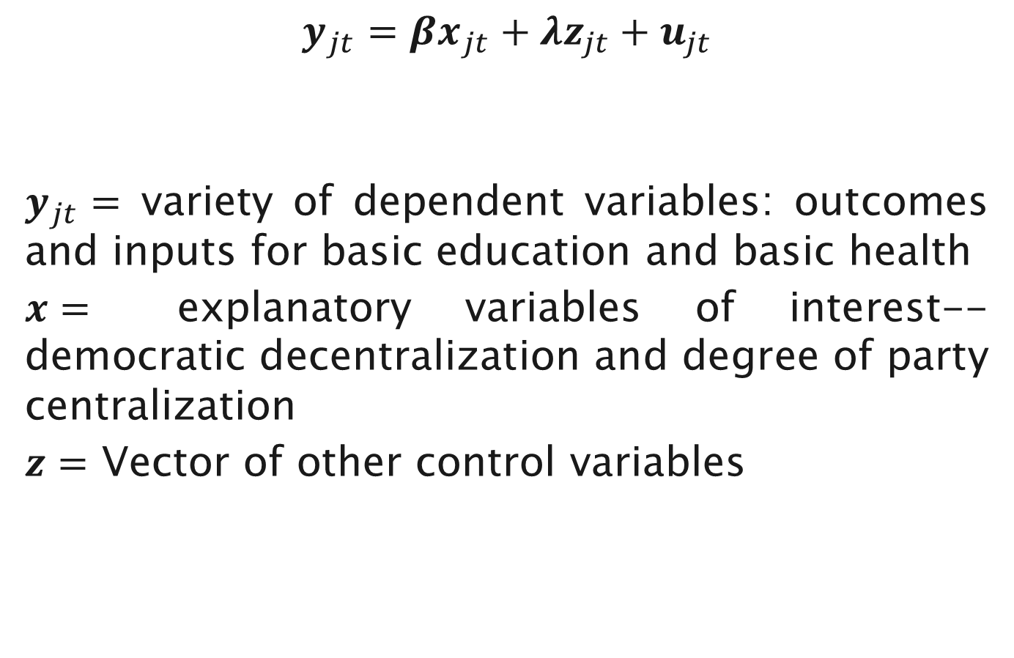
Basic estimation model
$$y_{jt}={βx}_{jt}+{λz}_{jt}+u_{jt}$$
$y_{jt}=$ variety of dependent variables: outcomes and inputs for basic education and basic health
$x=$ explanatory variables of interest-- democratic decentralization and degree of party centralization
$z=$ Vector of other control variables

Slide 16
Empirical Analysis
We use of a series of quantitative models of all electorally competitive countries from 1976 to 2006, contingent on data availability.
Our most expansive model considers 1929 observations and 135 countries, to our knowledge the broadest examination of sub-national political institutions in the literature.
For robustness we employ fourteen different measures of education policy and eighteen different measures of health policy to operationalize our dependent variable, capturing allocative efficiency and externalities.
Such measures are often used in the empirical literature to denote public goods provision at the sub-national
Notes:
We examine how party decentralization interacts with democratic decentralization to influence provision of public goods at the subnational level.
The first of our dummies, labeled Democratic Decentralization, Party Centralization, is coded “1” when (1) there are municipal elections, and (2) more than 75% of municipal council seats are held by national parties, and (3) national party leaders exercise centralized power over municipal party nomination (i.e. party centralization is coded “0” above). The second, labeled Democratic Decentralization, Party Decentralization, is coded “1” when (1) there are municipal elections, and (2) either fewer than 75% of municipal council seats are controlled by national parties or national party leaders do not control party nomination in municipal elections (i.e. party centralization is coded “1” or “2” above) or both. Note that both variables are coded “0” when there are no municipal elections, so that is the reference category.

Slide 17
Variables
  Education dependent variables:
  Primary Completion Rate, Primary School Teachers, Pre-primary Enrollment Rate, Primary Enrollment Rate, Secondary Enrollment Rate, Tertiary Enrollment Rate, Percent Children Out of School, etc … (see next)
Independent variables of interest:
  Democratic Decentralization, Party Centralization
Other control variables: Municipal Plurality, Municipal Directly Elected Executive, Fertility, Population Density, GDP per capita, Urban Population, Polity, World Region Dummies, Expenditure and Revenue Decentralization.
Estimation models: fixed effects, variable effects (with AR1 autocorrelation correction, decade dummies, and world region dummies) and system GMM.
Notes:
We examine how party decentralization interacts with democratic decentralization to influence provision of public goods at the subnational level.
The first of our dummies, labeled Democratic Decentralization, Party Centralization, is coded “1” when (1) there are municipal elections, and (2) more than 75% of municipal council seats are held by national parties, and (3) national party leaders exercise centralized power over municipal party nomination (i.e. party centralization is coded “0” above). The second, labeled Democratic Decentralization, Party Decentralization, is coded “1” when (1) there are municipal elections, and (2) either fewer than 75% of municipal council seats are controlled by national parties or national party leaders do not control party nomination in municipal elections (i.e. party centralization is coded “1” or “2” above) or both. Note that both variables are coded “0” when there are no municipal elections, so that is the reference category.

Slide 18
Education Dependent Variables | Computation Method (Source: World Bank) | Mean | Range
Primary School Enrollment Adjusted | The ratio of total enrollment in school to the total population of primary school age. | 88.40 | 25.74 to 100.00
Primary School Enrollment Adjusted – Female | The ratio of total female enrollment in school to the total female population of primary school age. | 86.26 | 21.35 to 100.00
Primary School Enrollment – Net | The ratio of total enrollment in primary school to the total population of primary school age. | 86.89 | 25.61 to 100.00
Primary School Enrollment – Net Female | The ratio of total female enrollment in primary school to the total female population of primary school age. | 84.65 | 21.18 to 99.99
Primary School Enrollment – Gender Parity | The ratio of girls to boys in primary school. | .948 | .496 to 1.17
Children Out of School | The ratio of primary aged children not enrolled in school to the total population under age 14. | 12.31 | 0 to 74.26
Children Out of School – Female | The ratio of primary aged girls not enrolled in school to the total population of girls under age 14. | 14.70 | 0 to 79.73
Net Intake Ratio in Grade One | The ratio of children of relevant age entering the first grade of primary school to children in the population of relevant age. | 61.16 | 11.95 to 99.06
Adult Literacy Rate | Percentage of population 15 years old and above who can read and write a simple sentence. | 74.87 | 12.85 to 99.77
Persistence to Fifth Grade | The percent of children enrolled in the first grade of primary school who eventually reach fifth grade. | 81.98 | 18.93 to 100
Primary Completion Rate | The ratio of total entrants in the last grade of primary school to the total population of relevant age. | 82.08 | 14.09 to 118.57
Primary Completion Rate -Female | The ratio of total female entrants in the last grade of primary school to the total female population of relevant age. | 80.76 | 11.08 to 121.03
Govt Education Expenditure - % Govt Spending | Government expenditure, at all levels, on education as a percent of total government expenditure. | 14.49 | 4.77 to 32.40
Govt Primary Education Expenditure - % Govt Spending on Ed | Government expenditure, at all levels, on primary education as a percent of total government education expenditure. | 35.66 | 1.26 to 98.67

Slide 19
Health Dependent Variables | Computation Method (Source: World Bank) | Mean | Range
Infant Mortality Rate | Number of infants dying before one year of age per 1000 live births. | 37.61 | 2.3 to 143.4
Public Health Expenditure -% GDP | Total public expenditure on health as a percentage of GDP. | 3.39 | .267 to 8.43
Public Health Expenditure - % Govt Spending | Total public expenditure on health as a percentage of total government spending. | 11.05 | 2.20 to 29.17
Children Receiving DPT Immunization | The percentage of children aged 12 to 23 months who have received adequate DPT vaccination. | 82.65 | 15 to 99
Children Receiving Hepatitis B Immunization | The percentage of children aged 12 to 23 months who have received adequate HepB3 vaccination. | 78.70 | 1 to 99
Children Receiving Measles Immunization | The percentage of children aged 12 to 23 months who have received adequate Measles vaccination. | 81.56 | 16 to 99
Improved Sanitation Facilities | Percent of population with access to improved sanitation facilities, generally those which separate waste from human contact. | 67.82 | 3 to 100
Improved Sanitation Facilities – Urban | Percent of urban population with access to improved sanitation facilities, generally those which separate waste from human contact. | 76.38 | 12.3 to 100
Improved Water Source | Percent of population with access to improved drinking water sources, such as piped water. | 83.44 | 21.4 to 100
Improved Water Source -Urban | Percent of urban population with access to improved drinking water sources, such as piped water. | 93.24 | 37.3 to 100
People Using Basic Drinking Water | Percent of population with access at to improved drinking water sources within a 30 minute round trip walk. | 81.42 | 16.73 to 100
People Using Basic Drinking Water – Urban | Percent of urban population with access at to improved drinking water sources within a 30 minute round trip walk. | 92.29 | 59.49 to 100
People Using Basic Sanitation | Percent of population with access to improved sanitation facilities, unshared with other households. | 67.99 | 3.15 to 100
People Using Basic Sanitation - Urban | Percent of urban population with access to improved sanitation facilities, unshared with other households. | 74.69 | 10.04 to 100
TB Detection Rate | Percent of estimated cases of tuberculosis in a given year which are reported to WHO. | 68.71 | 6.5 to 130
TB Treatment Success Rate | Percentage of registered tuberculosis cases which successfully completed treatment. | 75.12 | 9 to 97

Slide 20
Explanatory Variables | Computation Method and Source | Mean | Range | Expected Relationship with Good Governance Outcomes (sign may change according to direction of Y)
Democratic Decentralization, Party Centralization | Coded “1” when (1) there are municipal elections, and (2) more than 75% of municipal council seats are held by national parties, and (3) national party leaders control party nomination in municipal elections. (We use the variable "Ballot" in Carey and Shugart (1995) that allows incorporating the "degree" of power parties have to nominate candidates Based on the three component variables below). (Source: Original Dataset) | .515 | Dummy | Positive
Democratic Decentralization, Party Decentralization | Coded “1” when (1) there are municipal elections, and either (2) 75% or fewer of municipal council seats are held by national parties, or (3) national party leaders do not control party nomination in municipal elections. Based on the three component variables below. (Source: Original Dataset) | .320 | Dummy | Insignificant or Positive with a smaller sign than Democratic Decentralization, Party Centralization
Competitive Municipal Elections | Coded “1” when competitive elections are held at the municipal level. (Source: Original Dataset) | .837 | Dummy | Used to calculate the primary independent variables
Municipal Presence of National Parties | When Municipal Elections indicates the presence of municipal elections, this variable is coded “0” to “4”, with higher numbers indicating that national parties win more local seats. (Source: Original Dataset) | 2.62 | 0 to 4 | Used to calculate the primary independent variables
Municipal Party Decentralization | When Municipal Role of Parties indicates that national parties play a major role in municipal elections (i.e. is coded “3” or “4”), this variable is coded “0” to “2”, with higher numbers indicating that national parties have less control over nominating candidates for municipal elections. (Source: Original Dataset) | .303 | 0 to 2 | Used to calculate the primary independent variables
Municipal Centrally Appointed Executive | Coded “1” when national government appoints municipal executive. | .051 | Dummy | Negative
Municipal Directly Elected Executive | Coded “1” when (1) there are municipal elections, and (2) the municipal mayor or other executive is directly elected and cannot be removed by the municipal council. (Source: Original Dataset) | .309 | Dummy | Uncertain (Positive?)

Slide 21
Municipal Plurality | Coded “1” when (1) there are municipal elections, and (2) a plurality system is used to elect the municipal assembly. (Source: Original Dataset) | .257 | Dummy | Uncertain (Negative?)
Regional Elections | Coded “1” when competitive elections are held at the regional level (Source: Original Dataset) | .456 | Dummy | Uncertain (Positive?)
Programmatic vs. Clientelistic Parties | Party linkage sources, coded from pure clientelistic (0) to pure programmatic (4). (Source: V-Dem) | 2.31 | 0 to 4 | Positive
Polity : from authoritarian to pure democratic | Level of democracy, coded from pure authoritarian (-10) to pure democratic (10). (Source: Polity IV) | 5.23 | -9 to 10 | Positive
Subnational Taxation Power | Coded “1” when regional governments have the power to raise taxes. (Source: Variations in Federalism) | .398 | Dummy | Positive
Subnational Spending Power | Coded “1” when regional governments have authority in spending policy. (Source: Variations in Federalism) | .378 | Dummy | Positive
Fertility | Lagged average births per woman (Source: World Bank) | 3.15 | 1.08 to 7.79 | Negative
Logged GDP per capita | Lagged Logged GDP per capita ppp (Source: World Bank) | 8.91 | 5.91 to 11.13 | Positive
Logged Population Density | Lagged logged people per square kilometer (Source: World Bank) | 3.97 | .356 to 8.80 | Positive
National Legislative Electoral Competitiveness (Lagged) | Lagged Legislative Index of Electoral Competitiveness (Source: Database of Political Institutions) | N/A | 1 to 7 | Used to restrict dataset to countries with multiple parties in the national legislature (scoring 6 or 7)

Slide 22
Main expected results
If our theory is correct, we would expect the coefficient for Democratic Decentralization, Party Centralization to be statistically significant and associated with better governance… it produces better outcomes than the residual category of no local elections
We would also expect the coefficient for Democratic Decentralization, Party Decentralization to be associated with better governance, but to be either smaller or statistically insignificant.
Our theory would be borne out even more strongly if we could show that there is a statistically significant difference between our two primary explanatory variables.
In fact, this combination of significance for our first variable and insignificance for our second, which appears often in our models, is the best supporting evidence for our arguments.

Slide 23
Highlighted results for education models (1)
Variable | Model 1 | Model 2 | Model 3 | Model 4 | Model 5 | Model 6 | Model 7
 | Y= Primary School Enrollment Adjusted (N=857, 113 countries) | Y= Primary School Enrollment Adjusted- Female (N=754, 108 countries) | Y=Primary School Enrollment- Net (N=857, 113 countries) | Y=Primary School Enrollment – Net Female (N=754, 108 countries) | Y=Primary School Enrollment – Gender Parity (N=1603, 128 countries) | Y= Children Out of School (N=1182, 118 countries) | Y= Children Out of School - Female (N=1006, 114 countries)
Democratic Decentralization, Party Centralization (Lagged) | 2.81*** (.982) | 3.29*** (1.07) | 2.70*** (.980) | 3.19*** (1.06) | .008** (.003) | -2.20*** (.761) | -2.68*** (.859)
Democratic Decentralization, Party Decentralization (Lagged) | .577 (1.29) | .457 (1.40) | .603 (1.28) | .618 (1.39) | .003 (.005) | -.281 (1.04) | -.608 (1.13)
Significant Difference? | Yes (*) | Yes (**) | Yes (*) | Yes (*) | No | Yes (**) | Yes (**)

Slide 24
Highlighted results for education models (2)
Variable | Model 8 | Model 9 | Model 10 | Model 11 | Model 12 | Model 13 | Model 14
 | Y= Net Intake Ratio in Grade 1 (N=430, 82 countries) | Y=Adult Literacy Rate (N=195, 93 countries) | Y= Persistence to Fifth Grade (N=756, 92 countries) | Y= Primary Completion Rate (N=1152, 118 countries) | Y= Primary Completion Rate - Female (N=1075, 113 countries) | Y= Govt Education Expenditure, % Govt Spending (N=1013, 120 countries) | Y= Govt Primary Education Expenditure, % Govt Spending on Ed (N=783, 104 countries)
Democratic Decentralization, Party Centralization (Lagged) | 6.05*** (2.36) | 3.37* (1.90) | -1.20 (1.37) | .817 (.999) | 1.48 (1.10) | -.283 (.515) | 3.65*** (1.23)
Democratic Decentralization, Party Decentralization (Lagged) | 4.04 (2.97) | .524 (2.87) | -2.20 (1.95) | -1.11 (1.37) | -.279 (1.54) | -.575 (.648) | 4.10** (1.84)
Significant Difference? | No | No |  |  |  |  | No

Slide 25
Highlighted results for some of the Health Models
Variable | Model 1 | Model 2 | Model 3 | Model 4 | Model 5 | Model 6 | Model 7 | Model 8
 | Y=Infant Mortality Rate (N=1929, 135 countries) | Y= Public Health Expend-iture - % GDP (N=1633, 135 countries) | Y= Public Health Expend-iture - % Govt Spending (N=1628, 135 countries) | Y= Children Receiving DPT Immuniza-tion (N=1926, 135 countries) | Y= Children Receiving Hepatitis B Immuniza-tion (N=986, 114 countries) | Y=Children Receiving Measles Immuniza-tion (N=1929, 135 countries) | Y= Improved Sanitation Facilities (N=1895, 134 countries) | Y= Improved Sanitation Facilities- urban (N=1905, 134 countries)
Democratic Decentralization, Party Centralization (Lagged) | -.966*** (.307) | .282*** (.095) | .975*** (.343) | 1.73* (.991) | 22.53*** (3.89) | .684 (1.02) | -.015 (.114) | .169* (.092)
Democratic Decentralization, Party Decentralization (Lagged) | -.246 (.405) | .149 (.129) | .571 (.453) | .337 (1.26) | 13.08*** (4.10) | .745 (1.29) | .128 (.149) | .078 (.121)
Significant Difference? | Yes (*) | No | No | No | Yes (***) |  |  | No

Slide 26
Examples of results for various estimation models
Variable | Model 1 | Model 2 |  | Model 3 | Model 4 | Model 5
 | Y= Children Out of School (N=1182, 118 countries) Random Effects with AR(1) Correction | Y= Children Out of School (N=1182, 118 countries) Fixed Effects with Country and Year Dummies |  | Y= People Using Basic Drinking Water- Urban (N=1043, 128 countries) Random Effects with AR(1) Correction | Y= People Using Basic Drinking Water- Urban (N=1043, 128 countries) Fixed Effects with Country and Year Dummies | Y= People Using Basic Drinking Water- Urban (N=814, 126 countries) Arellano-Bond GMM with Lagged Y
Democratic Decentralization, Party Centralization (Lagged) | -2.20*** (.761) | -5.51*** (1.86) |  | .328*** (.120) | .659 (.773) | .257** (.122)
Democratic Decentralization, Party Decentralization (Lagged) | -.281 (1.04) | -.288 (1.78) |  | -.090 (.173) | -.632 (.606) | .201 (.125)
Significant Difference? | Yes(**) | Yes (***) |  | Yes (**) |  | No

Slide 27
Other significant control variables
  GDP per capita
  Fertility rate
  Population density
  Fiscal decentralization in revenues and expenditures
  Local executive directly elected
  Plurality electoral systems tend to provide public service delivery that is inferior to those with proportional electoral systems.

Slide 28
5. Conclusion and Policy Implications
Find support for the strong decentralization theorem: evidence that the combination of democratic decentralization and party centralization improves educational and health outcomes.
Evidence that sub-national governance impacts public service delivery, and that political institutions should meet certain pre-requisites to realize the benefits of decentralization (fiscal and political) reform.
Potentially important implications for countries that are decentralized or are considering decentralization to consider the appropriate political institutions/conditions to achieve the desired decentralization outcomes.
Of course, further studies needed in order to explore validity for other types of public service delivery.

Slide 29
Thank you

